Slide 1

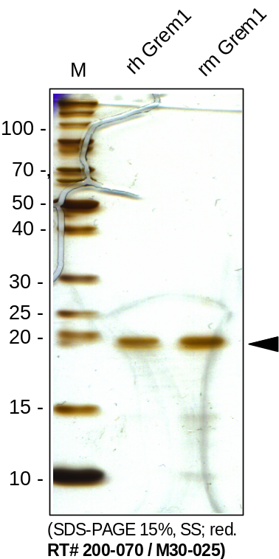
Reliatech GmbH
Recombinant human and mouse Gremlin-1 (Grem1)
(Cat #200-070 / M30-025)
Fig. 1: SDS-PAGE analysis of recombinant human and mouse Gremlin-1 (Grem1) derived from E. coli. Samples were loaded in 15% SDS-polyacrylamide gel under reducing conditions and stained with Silver stain.
http://www.reliatech.de / orders@reliatech.de

